Slide 1


E.G.S. Pillay Engineering College
An Autonomous Institution Affiliated to Anna University, Chennai | Approved by AICTE, New Delhi Accredited by NAAC with A++ Grade | Accredited by NBA T1 (B.E. – CIVIL,MECH,EEE,CSE,ECE & B.Tech – IT)
Old Nagore Road, Thethi, Nagore Village, Nagapattinam – 611002, Tamil Nadu, India
Information technology
IoT-Powered Adaptive Sleep Environment for Health & Wellness
Date& Session : 07/02/2026 Venue: SJB 314
Presented by, S.KALAISELVAN(8208E23ITR052) S.RAVIKUMAR(8208E23ITR095) K.KARTHIPAN(8208E23ITR054)
Under the Guidance of,
Dr.R.Manivannan M.Tech., PhD., Professor,
Department of Information Technology

Slide 2
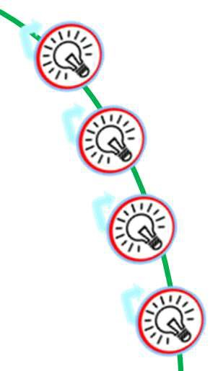
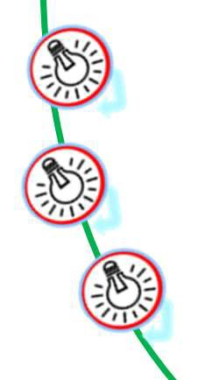
Outline of the Presentation
Abstract Objective
Problem statement Existing System &
Proposed System
System Architecture Literature reviews
Reference
2/13

Slide 3
Abstract
Sleep quality plays a vital role in human health and well-being. Most existing sleep monitoring systems only track sleep data and do not actively improve sleep conditions. This project proposes an IoT-powered adaptive sleep environment that monitors real-time biometric signals such as heart rate, body movement, and room temperature. Using cloud-based intelligence, the system analyzes sleep patterns and automatically controls environmental factors like lighting and airflow to improve sleep quality. The proposed solution is cost-effective, scalable, and suitable for smart home and healthcare applications.
3/13

Slide 4
Objective
To monitor real-time biometric parameters such as heart rate and body movement using IoT sensors
To collect and analyze sleep-related data through cloud connectivity
To identify individual sleep patterns and create personalized sleep profiles
To automatically control environmental conditions such as lighting and airflow
To improve sleep quality using an adaptive and intelligent IoT-based system

Slide 5
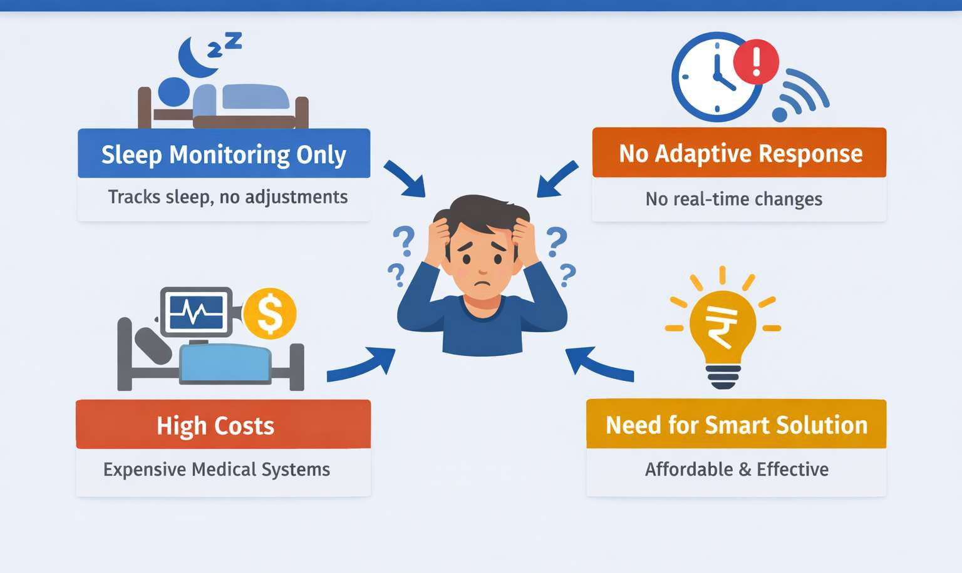
Problem statement
Poor sleep quality negatively affects physical health, mental well-being, and daily productivity. Existing sleep monitoring systems mainly focus on tracking sleep data and providing reports, but they do not actively improve sleep conditions. Additionally, current smart home systems operate with static or manual control and do not adapt based on individual sleep patterns or biometric data. Therefore, there is a need for a cost-effective IoT-based system that continuously monitors sleep-related parameters and automatically optimizes the sleeping environment to enhance overall sleep quality.

Slide 6

Existing System
Description
Existing sleep monitoring systems mainly focus on tracking sleep data such as heart rate or movement. Smart home systems provide manual or preset control of devices like lights and fans.
Disadvantages
Only monitors sleep, no automatic improvement
Uses static or manual control
No personalization for individual users
Cannot predict or prevent sleep disturbances
Medical sleep systems are expensive and intrusive
Limited integration between sleep data and environment control

Slide 7
Proposed System
Description
The proposed system is an IoT-powered adaptive sleep environment that continuously monitors biometric data and automatically adjusts the sleep environment using cloud intelligence.
Advantages
Real-time monitoring of biometric and environmental data
Automatically controls lighting, airflow, and temperature
Creates personalized sleep profiles
Predicts sleep disturbances and provides alerts
Cost-effective and suitable for home use
Fully integrated IoT, cloud, and mobile-based solution
7/13

Slide 8
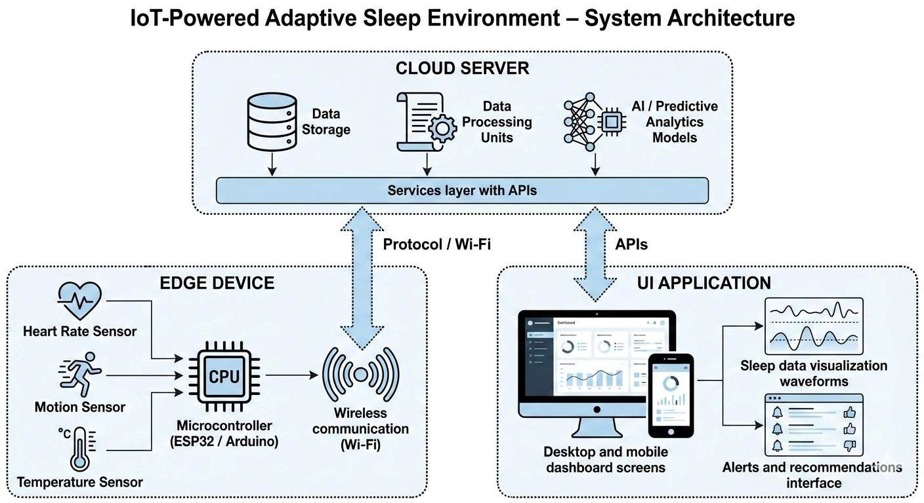
System Architecture

Slide 9

Requirements
Hardware Requirements | Software Requirements
Laptop / PC | Operating System: Windows / LinuxIDE
Processor: Intel i5 / AMD Ryzen 5 or higher | LinuxIDE: Arduino IDE, VS Code
RAM: Minimum 8 GB | Frontend: HTML, CSS, JavaScript Backend: Python / Node.js
Storage: Minimum 256 GB | Database: MySQL / MongoDBCloud
Internet Connection (for AWS IoT) | Platform: AWS IoT Core

Slide 10
Estimated Cost
Category | Components Included | Cost (₹)
Controllers | ESP32 + Arduino UNO | 1,300
Sensors | Heart Rate, PIR, DHT22 | 1,350
Smart Control | Relay, Smart Bulb, Fan Interface | 1,450
Power & Enclosure | Adapter, Wires, Project Box | 1,000
 | Total Cost Est | 5,100
10/13

Slide 11

Literature Review
Author & Year | Title | Key Contribution | Limitation
Saleem et al., 2020 | IoT Healthcare: Sleep Quality Monitoring | Low-cost IoT sleep monitoring using sensors | No adaptive environment control
Gamel & Talaat, 2024 | SleepSmart IoT System | AI-based personalized sleep analysis | Complex model, no smart home control
Do et al., 2025 | IoT-Based Sleep Monitoring using EEG | Cloud-based sleep analysis architecture | Expensive EEG hardware
11

Slide 12
References
Saleem, K., et al.
IoT Healthcare: Design of Smart and Cost-Effective Sleep Quality Monitoring System,
Journal of Sensors, 2020.
Gamel, S. A., & Talaat, F. M.
SleepSmart: IoT-Enabled Continual Learning for Intelligent Sleep Enhancement,
Neural Computing and Applications (Springer), 2024.
Do, C. T., et al.
IoT-Powered Mental Healthcare: Sleep State Analyzing and Monitoring Based on EEG Signals,
IEEE Access, 2025.
12/13

Slide 13
E.G.S. Pillay Engineering College
Thank you !
Presented by, S.KALAISELVAN(8208E23ITR052) S.RAVIKUMAR(8208E23ITR095) K.KARTHIPAN(8208E23ITR054)
13

